Slide 1

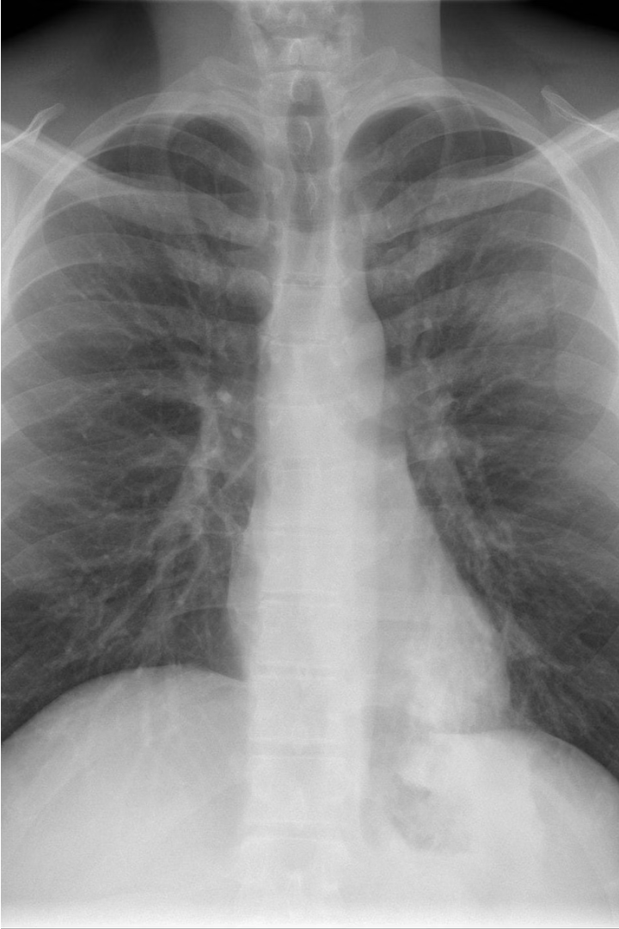
Introduction to Pneumonia Disease Detection System
Explore our cutting-edge pneumonia detection technology, revolutionizing early diagnosis and treatment. Powered by advanced AI algorithms, our system analyzes chest X-rays to identify signs of pneumonia with unparalleled accuracy.
Sa
Prepared By-
Samarth Saxena (E23MCAG0029)
Sagar Sharma (E23MCAG0023)

Slide 2
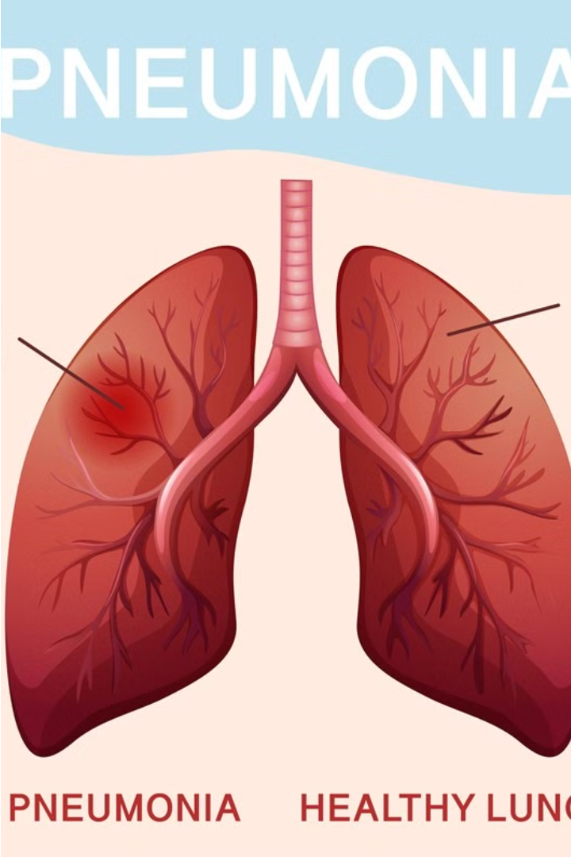
Understanding Pneumonia: Causes and Symptoms
Pneumonia is an infection of the lungs that can be caused by various pathogens, including bacteria, viruses, and fungi. Common symptoms include cough, fever, difficulty breathing, and chest pain. Understanding the underlying causes and recognizing early warning signs is crucial for timely diagnosis and treatment.
Viral and bacterial pneumonia are the most prevalent forms, often resulting from respiratory tract infections or weakened immune systems. Certain risk factors, such as age, chronic illnesses, and smoking, can increase the likelihood of developing severe pneumonia.

Slide 3
Importance of Early Detection
Improved Outcomes
Reduced Severity
Early detection of pneumonia can lead to prompt treatment, reducing the risk of complications and improving recovery rates.
Catching pneumonia in its early stages can help prevent the condition from worsening, minimizing the impact on a patient's health and wellbeing.
Decreased Hospitalizations
Saved Lives
Timely diagnosis and intervention can often allow for outpatient treatment, reducing the need for costly and disruptive hospital stays.
In severe cases, early detection of pneumonia can be the difference between life and death, making it a critical component of comprehensive healthcare.

Slide 4
Overview of the Detection System
Data Collection
1
The system collects chest X-ray or CT scan images from patients suspected of having pneumonia. Robust data collection protocols ensure high-quality, diverse datasets.
2
Image Processing
Collected images undergo preprocessing steps like normalization, resizing, and segmentation to extract relevant features for analysis.
Machine Learning Model
3
The preprocessed images are fed into a deep learning model trained to detect patterns indicative of pneumonia. The model is continuously refined for improved accuracy.

Slide 5
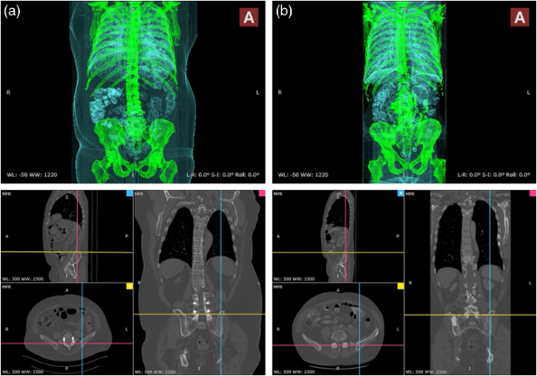
Data Collection and Preprocessing
Comprehensive data collection is crucial for the Pneumonia Disease Detection System. Medical imaging data, including chest X-rays and CT scans, are gathered from diverse healthcare facilities. This data is then preprocessed to ensure consistency, remove noise, and enhance the quality for optimal model training.

Slide 6
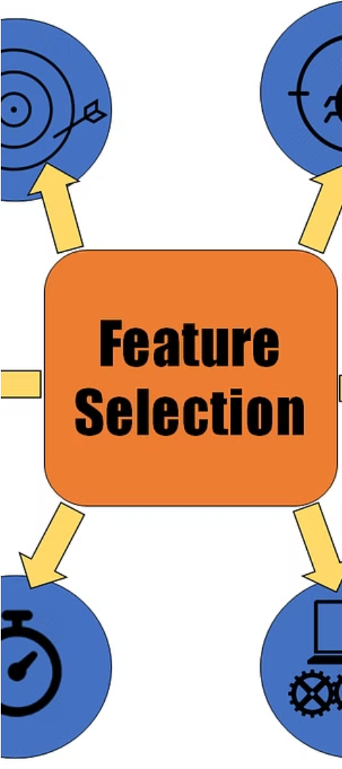



Feature Extraction and Selection
Data Preprocessing
Clean and normalize the input data, handling missing values and outliers to ensure high-quality features.
Feature Engineering
Create new features by combining or transforming the raw data, capturing key insights about pneumonia patterns.
Feature Selection
Identify the most informative features using techniques like correlation analysis and recursive feature elimination.

Slide 7
Machine Learning Algorithms
Logistic Regression
Decision Trees
Random Forest
Convolutional Neural Networks
An intuitive algorithm that recursively splits the data based on feature importance, creating a tree-like structure for predictions.
An ensemble learning method that combines multiple decision trees to improve accuracy and robustness.
A widely used algorithm for binary classification tasks, such as predicting whether a patient has pneumonia or not.
Powerful deep learning models that excel at image recognition, which can be applied to analyze chest X-rays for pneumonia detection.

Slide 8
Model Training and Validation
To ensure the accuracy and reliability of the pneumonia detection system, the machine learning models undergo rigorous training and validation. The training process involves feeding the model vast amounts of labeled chest X-ray images, allowing it to learn the distinctive patterns and features associated with pneumonia.
Validation is crucial to evaluate the model's performance. Cross-validation techniques, such as k-fold cross-validation, are used to assess the model's generalization capabilities and catch any potential overfitting issues. This ensures the model can accurately predict pneumonia in new, unseen data.
Model Performance Metrics
Accuracy
Precision
Recall
F1-Score
Pneumonia Detection Model
92%
94.1%
90.8%
92.4%

Slide 9
Deployment and Integration
Pilot Project
1
Initial deployment in selected hospitals
Product Refinement
2
Feedback-driven improvements
Nationwide Rollout
3
Scaling the solution across the country
The Pneumonia Disease Detection System will be carefully deployed in a phased approach. We will first pilot the solution in select hospitals to gather feedback and refine the product. Once the system is optimized, we will initiate a nationwide rollout, making the technology available to healthcare providers across the country. Seamless integration with existing hospital infrastructure will be a key focus during deployment.

Slide 10

Conclusion and Future Enhancements
In conclusion, the Pneumonia Disease Detection System developed in this presentation offers a robust and reliable solution for early diagnosis of pneumonia. By leveraging advanced machine learning algorithms and comprehensive data analysis, the system can accurately identify the presence of pneumonia, enabling timely treatment and improved patient outcomes.
Looking to the future, there are exciting opportunities to further enhance the system. Ongoing research and development in the field of medical imaging and artificial intelligence can lead to even more accurate and sensitive detection capabilities. Additionally, integrating the system with real-time monitoring and telemedicine platforms can enable remote monitoring and early intervention, particularly in underserved communities.

